Slide 1
It service Desk
By : Drew DiFilippo, Manny Sanchez, Ethan Wilburn

Slide 2
Table of Contents
01
02
03
04
Introduction
What is the helpdesk and why did we choose it?
Exploring the database
What data types did we primarily use?
Exploring the database
Normal queries and subqueries
Conclusion

Slide 3
01
What is the service desk?

Slide 4
The service desk is
Located on 2nd floor Unistructure – Rotunda
Composed of both students and staff
A place to bring your technical issues and problems and get them solved
Where you get all your licenses fixed for classes

Slide 5
At the It service desk, we deal with various tasks such as
Internet troubleshooting
Laptop repairs
Password changes/resets
Monitor support
Loaner laptops / other technology
Account generation
And many more...

Slide 6
Why we chose it
We all have a background in the job and have worked together for multiple semesters
We believed it would make a great database given the names of tables and data types
The helpdesk did not already have an existing SQL database
Working with familiar data is comfortable

Slide 7
02
Exploring our Database

Slide 8

Summary of database:
Ticket system is our "main" table
Used VarChar, Binary, and Text for datatypes

Slide 9
03
The Queries

Slide 10
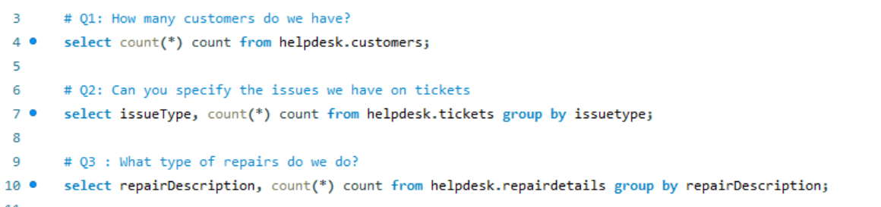

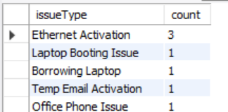
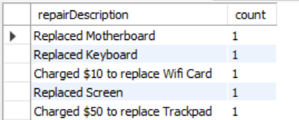
Basic one Table queries
2nd
3rd

Slide 11
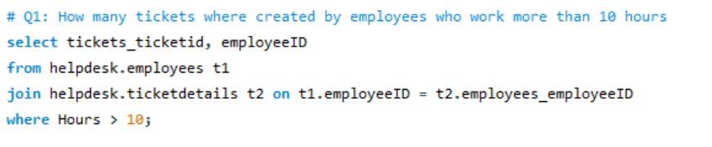
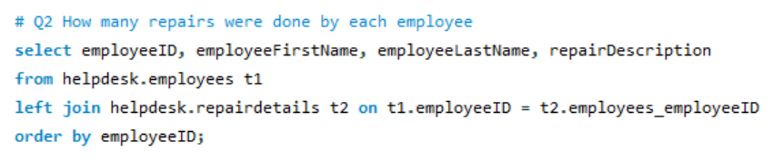
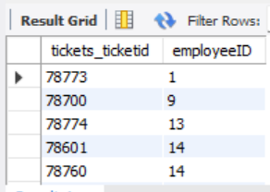
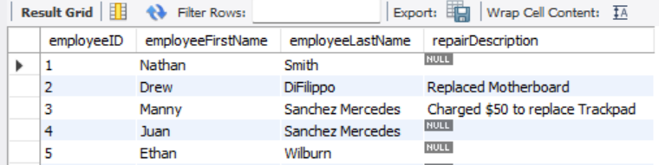
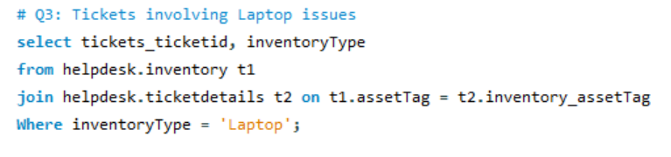
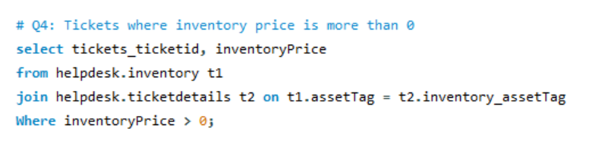
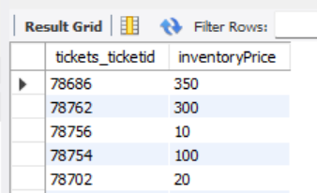
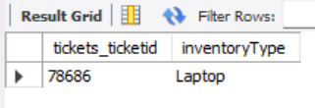
Multi-Table Queries

Slide 12
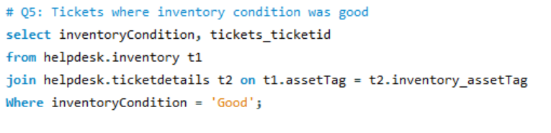
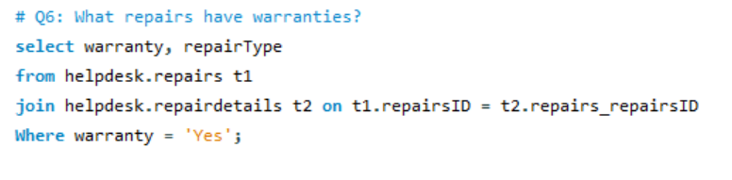
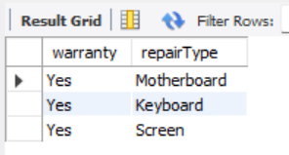
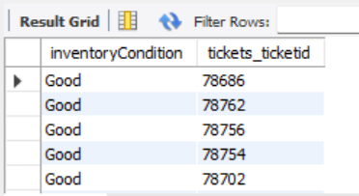
Multi-Table Queries(Continued)

Slide 13
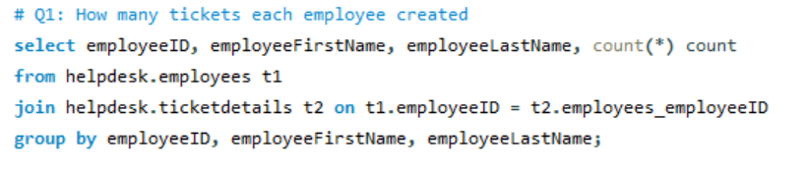
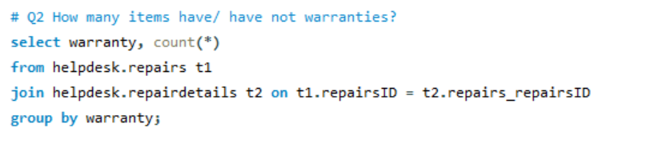
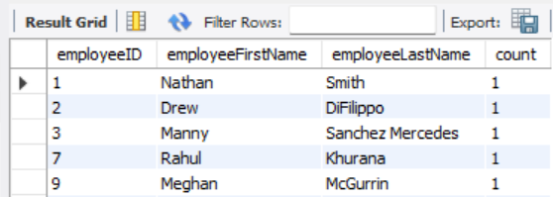
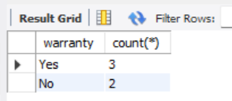
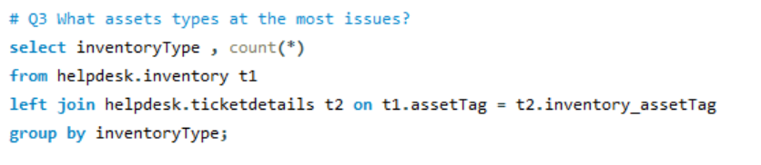
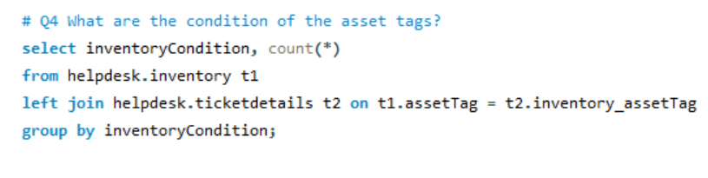
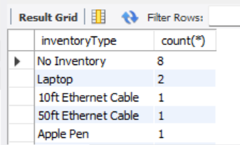
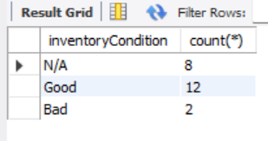
Summary Queries

Slide 14
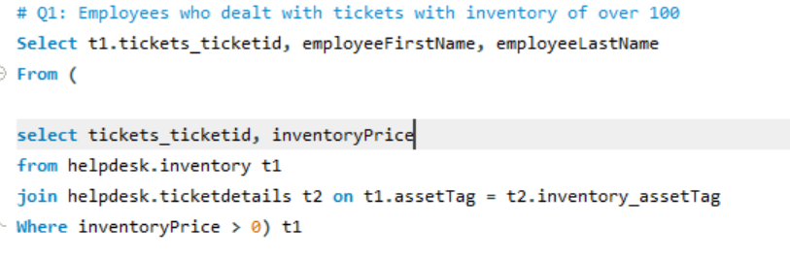
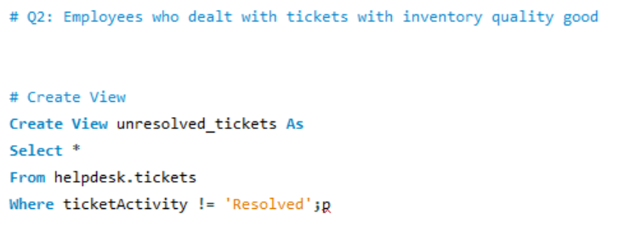

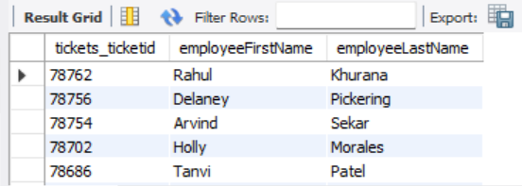
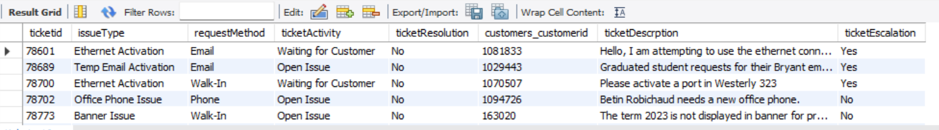
Subqueries/view

Slide 15
04
Conclusion

Slide 16
In conclusion
We chose the helpdesk because we are familiar with the data and have worked there for a couple of semesters
The queries are helpful for real business-related questions
The database can give a deeper insight to the helpdesk and what we could spend more of our time on

Slide 17
Thanks!
Questions?

